Slide 1



Lesson 3
Introduction to Security
Ordering, Basic Views
Actions & Menus

Slide 2
Introduction to Security

Slide 3









Access Rights
The ir.model.access CSV file for is used to create security access rules.
Contains the following columns:
id - external identifier for the access rule.
name - name of the access rule.
model_id:id - ID of the model that the access rule applies to.
group_id:id - ID of the group that the access rule applies to.
perm_read - read permission for the access rule.
perm_write - write permission for the access rule.
perm_create - create permission for the access rule.
perm_unlinfi - unlink permission for the access rule.
id,name,model_id:id,group_id:id,perm_read,perm_write,perm_create,perm_unlink access_test_model,access_test_model,model_test_model,base.group_user,1,0,0,0

Slide 4
Ordering, Basic Views

Slide 5



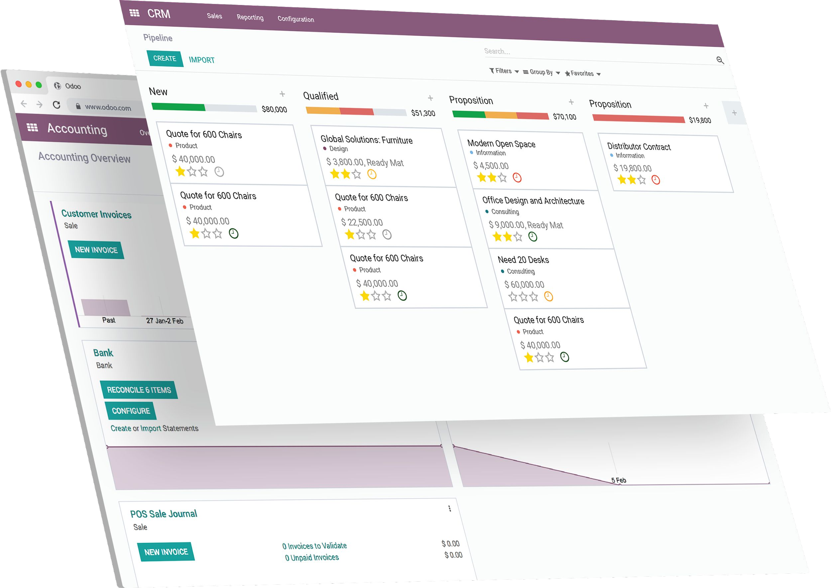
Fields attributes (again)
string
invisible
Modification in the views can
readonly
be done with python code
required
using the fields attributes.
default
domain
info = fields.Char(string="Test", required=True, default="test")

Slide 6






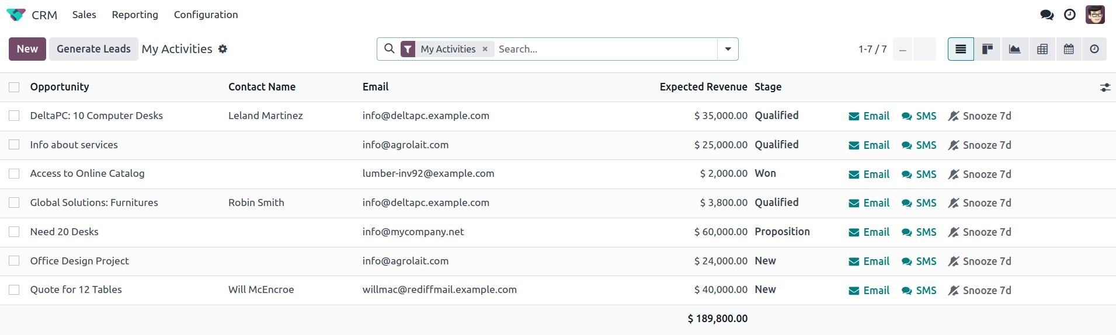

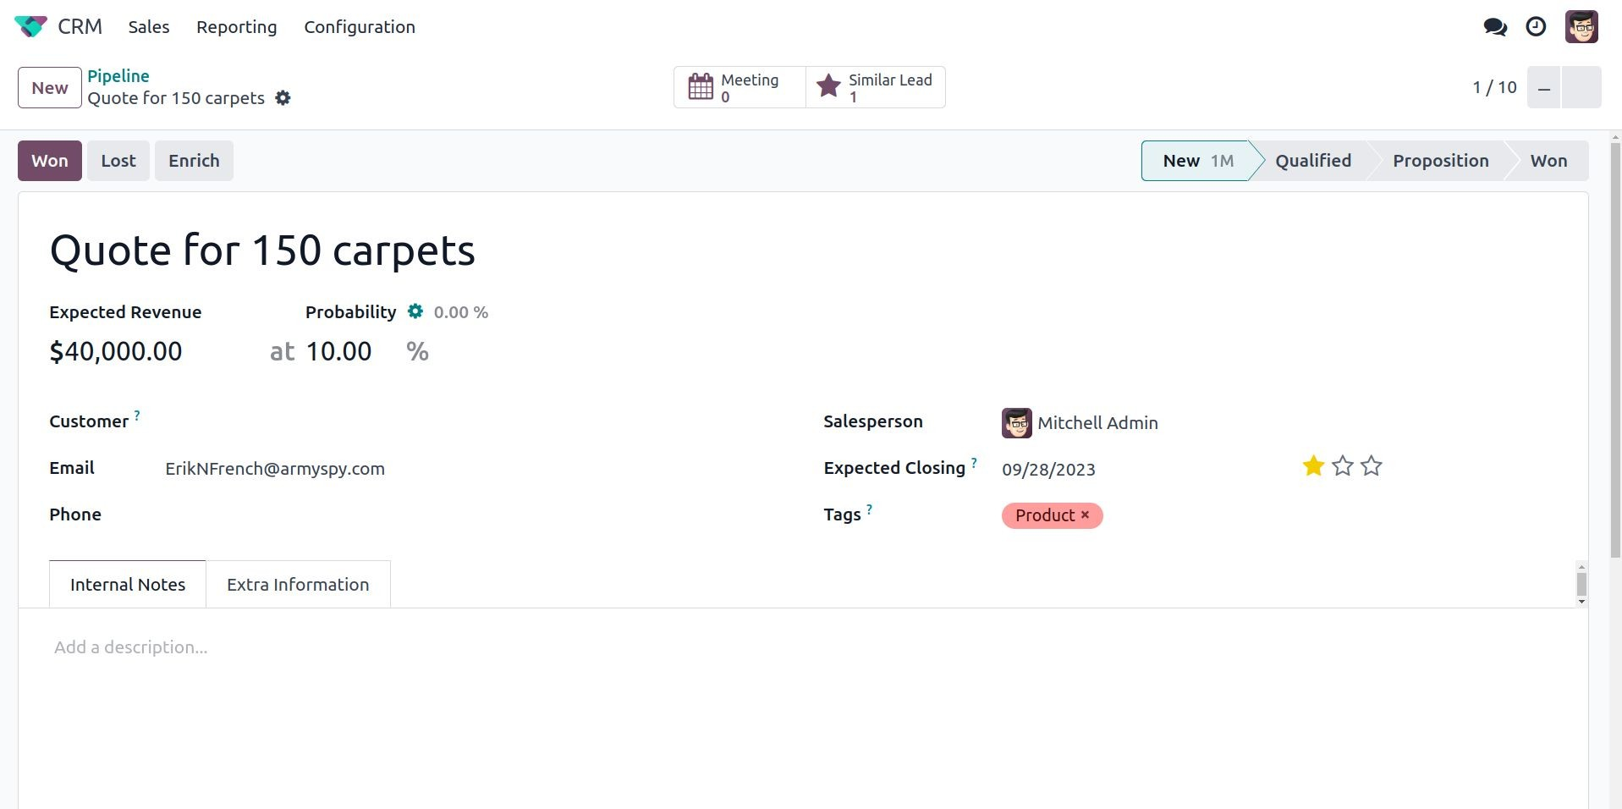

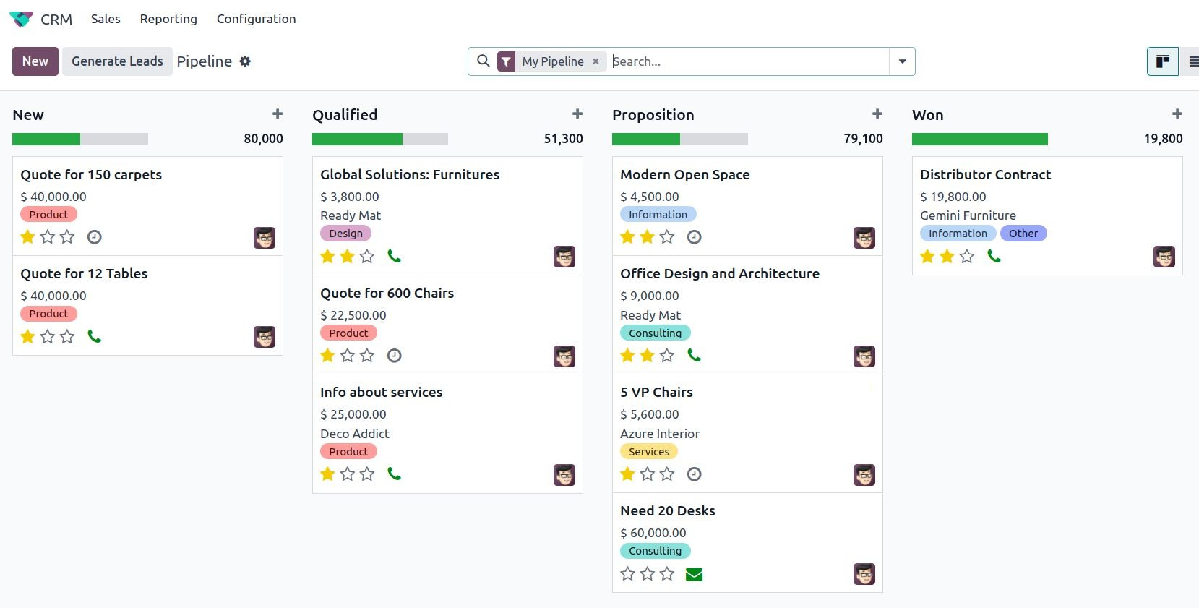

Basic views
menu
action
views

Slide 7


Basic views
Views = instances of the ir.ui.view model.
Different types
list (tree)
form
search
kanban
pivot
map
<record id="MODEL_view_TYPE" model="ir.ui.view">
<field name="name">model.view.type</field>
<field name="model">model</field>
<field name="arch" type="xml">
<VIEW_TYPE>
<VIEW_SPECIFICATIONS/>
</VIEW_TYPE>
</field>
</record>
…

Slide 8





List (or tree) views
<tree string="My activities">
<field name="opportunity"/>
<field name="contact_name"/>
<field name="email"/>
...
</tree>

Slide 9
Form views
Display, create and edit single records
Composed of :
high-level structure - groups and notebooks
Interactive elements - buttons and fields

Slide 10




Form views
<form>
<header>
<field name="state" widget="statusbar"/>
</header>
<sheet>
<div class="oe_button_box">
<BUTTONS/>
</div>
<group>
<group>
<field name="name"/>
</group>
</group>
<notebook>
<page string="Page1">
<group>
<CONTENT/>
</group>
</page>
<page string="Page2">
<group>
<CONTENT/>
</group>
</page>
</notebook>
</sheet>
</form>

Slide 11


Form views
<form>
<header>
<field name="state" widget="statusbar"/>
</header>
<sheet>
<div class="oe_button_box">
<BUTTONS/>
</div>
<group>
<group>
<field name="name"/>
</group>
</group>
<notebook>
<page string="Page1">
<group>
<CONTENT/>
</group>
</page>
<page string="Page2">
<group>
<CONTENT/>
</group>
</page>
</notebook>
</sheet>
</form>

Slide 12

Form views
<form>
<header>
<field name="state" widget="statusbar"/>
</header>
<sheet>
<div class="oe_button_box">
<BUTTONS/>
</div>
<group>
<group>
<field name="name"/>
</group>
</group>
<notebook>
<page string="Page1">
<group>
<CONTENT/>
</group>
</page>
<page string="Page2">
<group>
<CONTENT/>
</group>
</page>
</notebook>
</sheet>
</form>

Slide 13

Form views
<form>
<header>
<field name="state" widget="statusbar"/>
</header>
<sheet>
<div class="oe_button_box">
<BUTTONS/>
</div>
<group>
<group>
<field name="name"/>
</group>
</group>
<notebook>
<page string="Page1">
<group>
<CONTENT/>
</group>
</page>
<page string="Page2">
<group>
<CONTENT/>
</group>
</page>
</notebook>
</sheet>
</form>

Slide 14

Form views
<form>
<header>
<field name="state" widget="statusbar"/>
</header>
<sheet>
<div class="oe_button_box">
<BUTTONS/>
</div>
<group>
<group>
<field name="name"/>
</group>
</group>
<notebook>
<page string="Page1">
<group>
<CONTENT/>
</group>
</page>
<page string="Page2">
<group>
<CONTENT/>
</group>
</page>
</notebook>
</sheet>
</form>

Slide 15

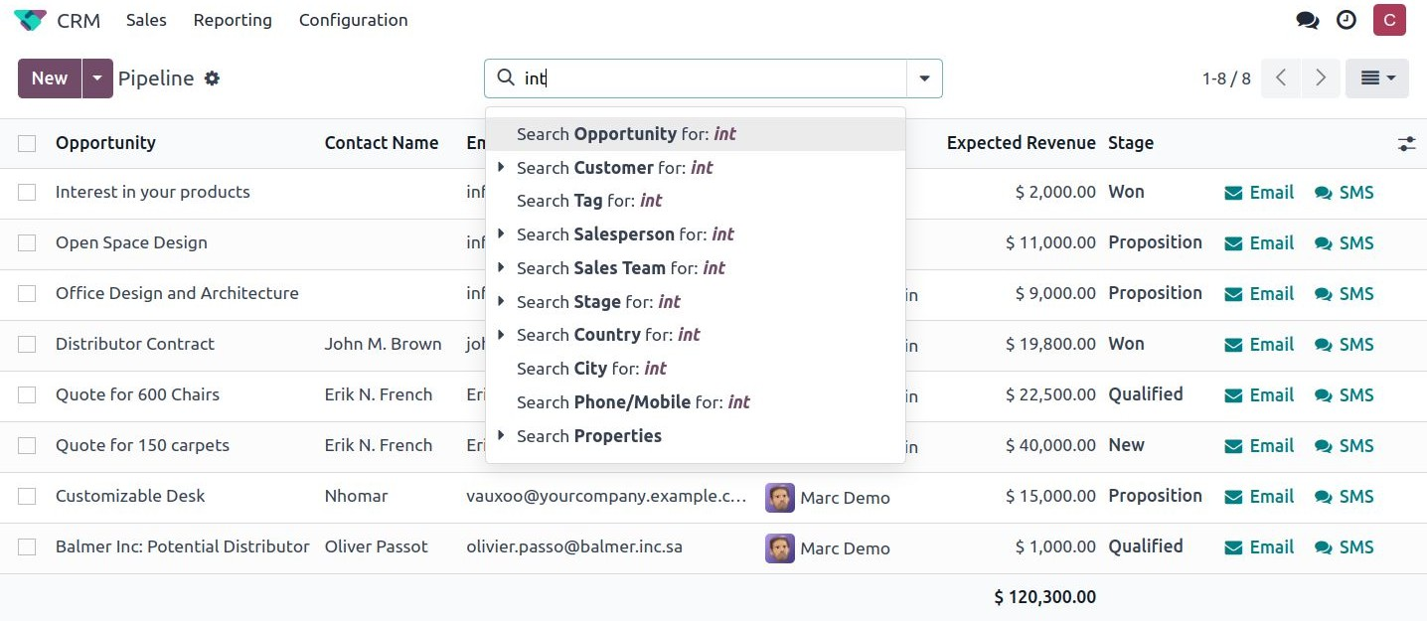


Search views
Doesn’t display content
Filter other view’s content
<search string="Tests">
<field name="name"/>
<field name="last_seen"/>
</search>

Slide 16



Search domain
Add complexity with list of criteria to select a subset of a model’s records
Each criterion is a triplet with a (‘field_name’, ‘operator’, ‘value’) operators: =, =, <, >, like, ilike, in, …
[('product_type', '=', 'service'), ('unit_price', '>', 1000)]
select products ‘which types are services AND with a unit price greater than 1000’
Logical operator s (AND), | (OR) and ! (NOT) can be used in and between criteria.
['|', ('product_type', '=', 'service'), '!', '&', ('unit_price', '>=', 1000), ('unit_price', '<', 2000)]
select products ‘which are services OR have a unit price which is NOT between 1000 and 2000’

Slide 17







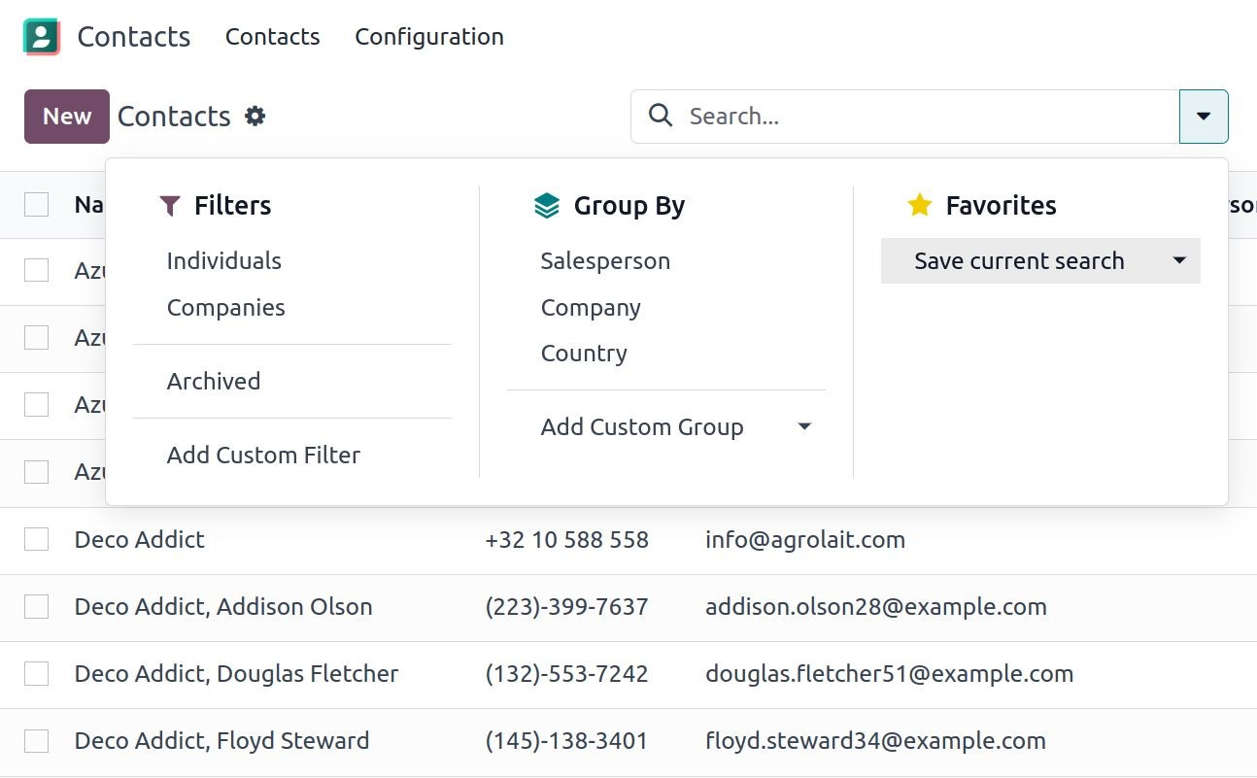
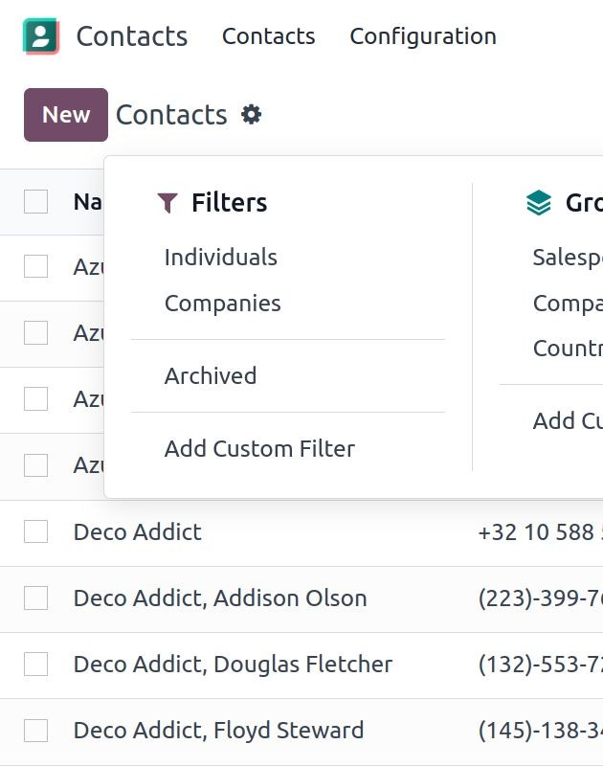
Advanced ﬁlter
Search views can contain <filter> elements and act as toggles for predefined searches.
Group ky Filters

Slide 18





Advanced ﬁlter
Group ky
Using the context and the key group_by
<search string="Tests">
<group string="Group By">
<filter name="group_by_field" context="{'group_by:'field'}"/>
</group>
</search>
Groups result into subsets based on field.
Filters
Using the domain attribute
Records filtered based on domain.
<search string="Tests">
<filter string="New State" name="filter_new_state"
domain="[('state','=','new')]"/>
</search>

Slide 19



Ordering
2 ways of ordering
Model Ordering - Based on fields values
Manual Ordering

Slide 20





Model Ordering
from odoo import fields, models
Using the _order attribute in the model
class TestModel(models.Model):
_name = "test_model"
_description = "Test Model"
_order = "date,price desc"
Will be converted to an
order_by clause in SQL
date = fields.Date() price = fields.Float()
(using asc as default sorting direction)

Slide 21





View Ordering
From tree view attribute
using default_order
<tree string="My activities" default_order="date desc">
<field name="opportunity"/>
<field name="date"/>
<field name="price"/>
...
</tree>
In different tree views if should be sorted differently
<tree string="My activities" default_order="price">
<field name="opportunity"/>
<field name="date"/>
<field name="price"/>
...
</tree>

Slide 22



Manual Ordering
from odoo import fields, models
class TestModel(models.Model):
_name = "test_model"
_description = "Test Model"
_order = "sequence desc"
sequence = fields.Integer(default=1)
Create sequence integer field and use model ordering on it
Define in tree view and use of widget handle
<tree string="My activities" >
<field name="sequence" widget="handle"/>
<field name="opportunity"/>
<field name="contact_name"/>
<field name="email"/>
...
</tree>

Slide 23
Actions & Menus

Slide 24


Action
Use
Open different types of window
Open specific data/set of data
Triggered by
clicking on menu items
clicking on buttons in views
contextual actions on object

Slide 25



Action
id - external identifier
<record id="test_model_action"
model="ir.actions.act_window">
<field name="name">Test action</field>
<field name="res_model">test.model</field>
<field name="view_mode">tree,form</field>
</record>
model - fixed value of ir.actions.act_window
name - name of the action
res_model - model which the action applies to
view_mode - views that will be available
(tree, form, …)

Slide 26




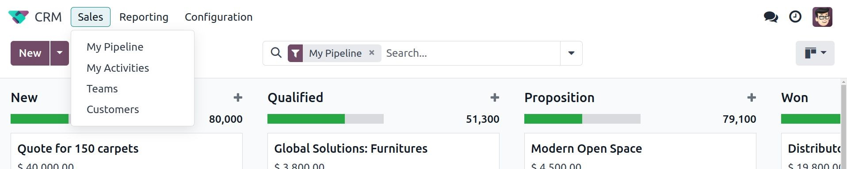


Menus
1
Using shortcuts, menus declaration will follow a three level architecture:
root menu
first level menu, displayed
in the top bar.
2
3. actions menus
3
<menuitem id="test_menu_root" name="Test"> 1
<menuitem id="test_app_level_menu" name="App Level"> 2
<menuitem id="test_model_menu_action" action="test_model_action"/>
</menuitem>
</menuitem>
3

Slide 27


Exercise
Create access rights for the new custom model.
Lesson 3
Access rights
1) In the estate module, in the directory to store our security data files created in the last chapter, add a new CSV access file ir.model.access.csv .
In addition to the header line, add 2 different access rights lines.
-> 1 with readonly permission for base.group_user
-> 1 full access for custom admin group module_name.estate_admin
Don’t forget to add the file in the manifest .
Help: Remember the example given in the warning of in the command line while loading DB. To gain some time, you can copy/paste the warning there in the manifest

Slide 28
Exercise
Add new attributes to the fields.
Lesson 3
Access rights
Fields view attrs
Chapter 6
FAicetliidonvsiew attrs Menu
set the selling price as read-only.
prevent copying of the availability date and the selling price values.
the default number of bedrooms is 2
4) the default availability date is in 3 months
→Tip: this might help you: today()
Field view attrs
Add fields to the estate.property model:
active : Boolean field(default true)
state : Selection field.
-> Possible values: New, Offer Received, Offer Accepted, Sold, Canceled.
→ must be required, should not be copied and default value set to ‘New’.

Slide 29
Exercise
Add a custom list view to the estate.property model.
Check next slide for visual Goal
Lesson 3
Access rights
Fields view attrs
List View
1) do not add the editable="bottom" attribute that you can find in the example above. We’ll come back to it later.
2) some field labels may need to be adapted to match the reference.
Field view attrs
List view
Help: We start using -u "module_name" and --dev xml in command to restart module

Slide 30

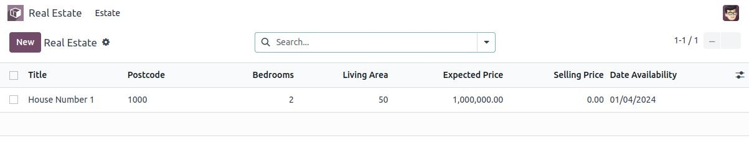
Exercise
Lesson 3
Access rights
Fields view attrs
List View
Goal: at the end of this section, the list view should look like this:

Slide 31

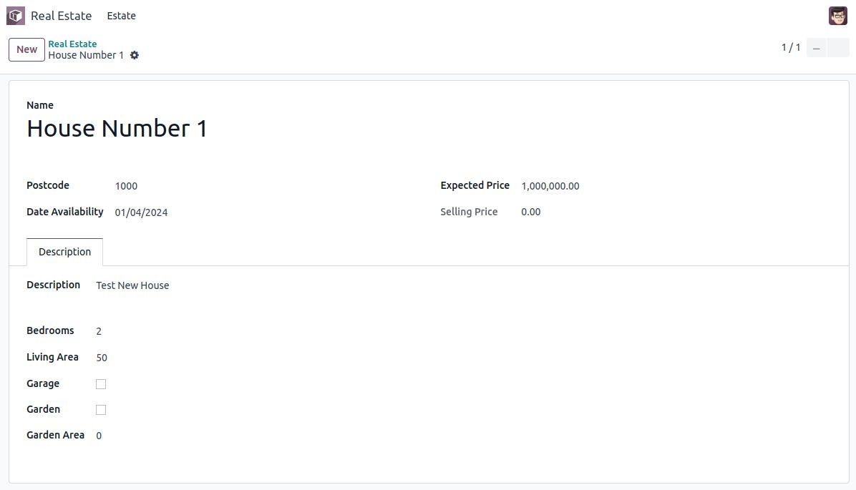
Exercise
Add a custom form view.
Lesson 3
Access rights
Fields view attrs
List View
Form View
1) Define a form view for the estate.property model in the appropriate XML file. Try to match the following example:

Slide 32
Exercise
Lesson 3
Access rights
Fields view attrs
List View
Form View
Search View
Add a custom search view to the estate.property model.
1) The following fields should be searchable:
title, postcode, expected price, bedrooms, living area, façades

Slide 33

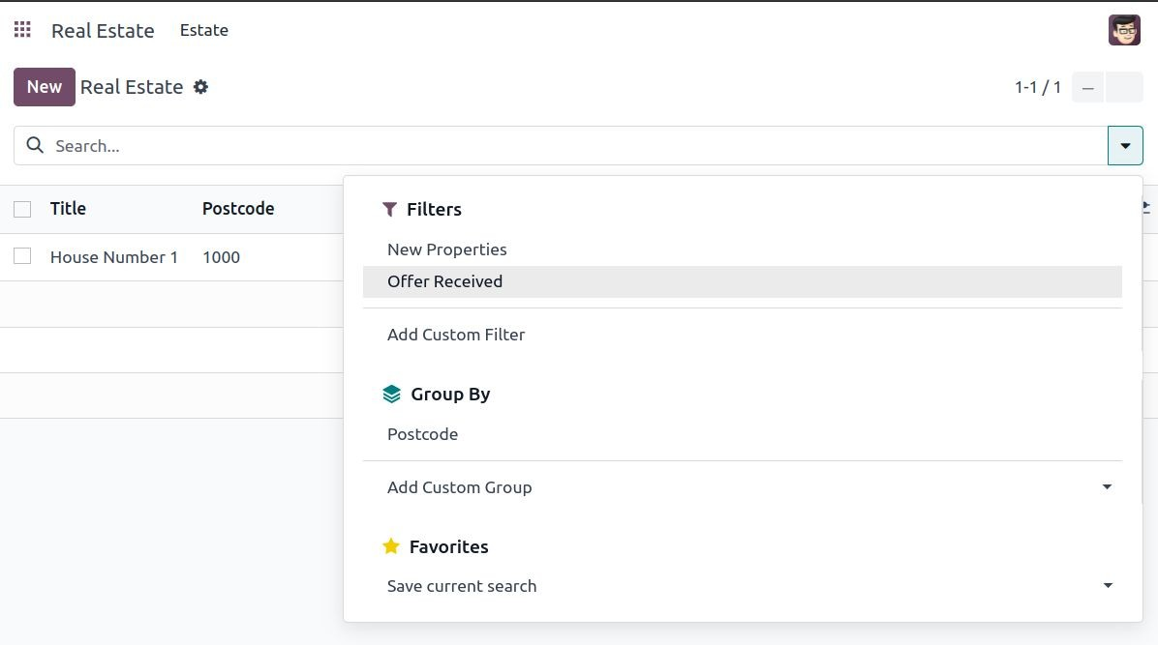
Exercise
In the search view of the estate.property model, Add the following Filters and Group By.
Lesson 3
Access rights
Fields view attrs
List View
Form View
Search View
1) Filters to display available properties,
i.e. the state should be ‘New’ or ‘Offer Received’.
2) The ability to group results by postcode.

Slide 34
Exercise
Add a new action for the new custom model.
Lesson 3
Access rights
Fields view attrs
List View
Form View
Search View
Action
1) In the estate module, add a new directory to store our views data files.
In this directory, create a new xml file estate_property_views.xml to store the views and actions for the related model (don’t forget to define it the manifest manifest too).
Create an action for the model estate.property.
To do so, create a record in the ir.actions.act_window model. Then add a name, res_model and view_mode in the fields.
NB: set “tree,form” in the view modes.

Slide 35
Exercise
Add menus for the new custom model.
Lesson 3
Access rights
Fields view attrs
List View
Form View
Search View
Action
Action Menu
1) In the estate module, in the previously created views directory create a new xml file estate_menu.xml to store the menus of the module (don’t forget to define it the manifest manifest too).
2) Create the three levels of menus for the estate.property action created in the previous exercise.
Help: Remember that we create different groups to give different types of access. If you want to be able to create or modify records, you might need to add your user in the right group.

